Slide 1
CEN 3078 Computer Security
Module 4 – Security Analytics

Slide 2
Security architectures
Moving target defense, Defense by pretense
Anomaly detection
Threat intelligence collection
Penetration testing
Risk assessment and management
Module-4: Discussion Topics

Slide 3
Security architectures
Moving target defense, Defense by pretense
Anomaly detection
Threat intelligence collection
Penetration testing
Risk assessment and management
Module-4: Discussion Topics

Slide 4
IT Security Management
What assets need to be protected
How are those assets threatened
What can be done to counter those threats
Helps in determining a clear view of an organization’s IT security objectives, security/privacy policies and general risk profile
Formal (iterative) process of answering questions such as:
Ensures that critical assets are sufficiently protected in a cost-effective manner
Security risk assessment is needed for each asset in the organization that requires protection
Provides the information necessary to decide what management, operational, and technical controls are needed to reduce the risks identified
Notes:
IT security management is the formal process of answering these questions, ensuring
that critical assets are sufficiently protected in a cost-effective manner. More specifically,
IT security management consists of first determining a clear view of an organization’s IT
security objectives and general risk profile. Next, an IT security risk assessment is needed
for each asset in the organization that requires protection; this assessment must answer
the three key questions listed above. It provides the information necessary to decide
what management, operational, and technical controls are needed to either reduce
the risks identified to an acceptable level or otherwise accept the resultant risk. This
chapter will consider each of these items. The process continues by selecting suitable
controls and then writing plans and procedures to ensure these necessary controls
are implemented effectively. That implementation must be monitored to determine if
the security objectives are met. The whole process must be iterated, and the plans and
procedures kept up-to-date, because of the rapid rate of change in both the technology
and the risk environment. We discuss the latter part of this process in Chapter 15. The
following chapters, then, address specific control areas relating to physical security in
Chapter 16, human factors in Chapter 17, and auditing in Chapter 18.

Slide 5
IT Security Management [ISO13335]
Helps to achieve and maintain appropriate levels of confidentiality, integrity, availability, accountability, authenticity, and reliability and involves functions such as:
Determining organizational IT security objectives, strategies, and policies
Determining organizational IT security requirements
Identifying and analyzing security threats to IT assets within the organization
Identifying and analyzing risks
Specifying appropriate safeguards
Monitoring the implementation and operation of safeguards that are necessary in order to cost effectively protect the information and services within the organization
Developing and implementing a security awareness program
Detecting and reacting to incidents
Notes:
[ISO13335] provides a conceptual framework for managing security. It defines
IT security management as follows:
IT SECURITY MANAGEMENT: A process used to achieve and maintain appropriate
levels of confidentiality, integrity, availability, accountability, authenticity, and reliability.
IT security management functions include:
• determining organizational IT security objectives, strategies, and policies
• determining organizational IT security requirements
• identifying and analyzing security threats to IT assets within the organization
• identifying and analyzing risks
• specifying appropriate safeguards
• monitoring the implementation and operation of safeguards that are necessary in
order to cost effectively protect the information and services within the organization
• developing and implementing a security awareness program
• detecting and reacting to incidents

Slide 6
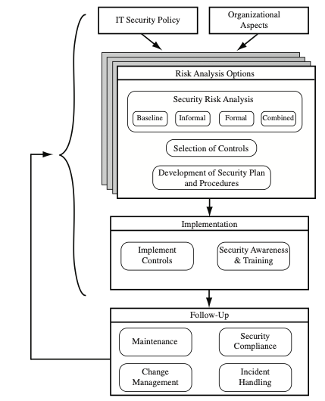
IT Security Management is a Cyclic Process
Cyclic process of must be repeated constantly in order to keep pace with the rapid changes in both IT technology and the risk environment
Notes:
This process is illustrated in Figure 14.1 (adapted from figure 1 in ISO27005 (Information security risk management, 2005) and
figure 1 in ISO13335, part 3]), with a particular
focus on the internal details relating to the risk assessment process. IT security management
needs to be a key part of an organization’s overall management plan. Similarly,
the IT security risk assessment process should be incorporated into the wider risk
assessment of all the organization’s assets and business processes. Hence, unless senior
management in an organization are aware of, and support, this process, it is unlikely
that the desired security objectives will be met and contribute appropriately to the
organization’s business outcomes. Note that IT management is not something undertaken
just once. Rather it is a cyclic process that must be repeated constantly in order
to keep pace with the rapid changes in both IT technology and the risk environment.

Slide 7
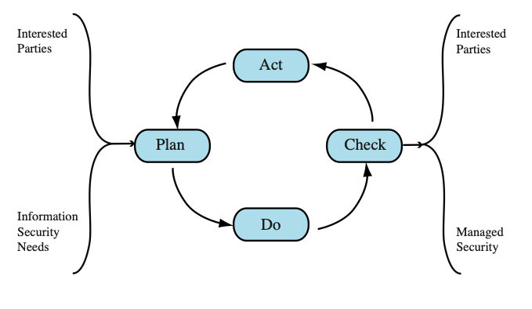
Plan – Do – Check - Act Process Model
Plan: Establish security policy, objectives, processes and procedures; perform risk assessment; develop risk treatment plan with appropriate selection of controls or acceptance of risk
Do: Implement the risk treatment plan
Check: Monitor and maintain the risk treatment plan
Act: Maintain and improve the information security risk management
process in response to incidents, review, or identified changes
Notes:
This process is illustrated in Figure 14.1 (adapted from figure 1 in ISO27005 (Information security risk management, 2005) and
figure 1 in ISO13335, part 3]), with a particular
focus on the internal details relating to the risk assessment process. IT security management
needs to be a key part of an organization’s overall management plan. Similarly,
the IT security risk assessment process should be incorporated into the wider risk
assessment of all the organization’s assets and business processes. Hence, unless senior
management in an organization are aware of, and support, this process, it is unlikely
that the desired security objectives will be met and contribute appropriately to the
organization’s business outcomes. Note that IT management is not something undertaken
just once. Rather it is a cyclic process that must be repeated constantly in order
to keep pace with the rapid changes in both IT technology and the risk environment.

Slide 8
Organizational Context and Security Policy
Maintained and updated regularly
Using periodic security reviews
Reflect changing technical/risk environments
Examine role and importance of IT systems in organization
Which essential decisions depend on the accuracy, currency, integrity, or availability of data managed by the IT systems?
What data created, managed, processed, and stored by the IT systems need protection?
What are the consequences to the organization of a security failure in their IT systems?
First examine organization’s IT security:
Objectives - wanted IT security outcomes
Strategies - how to meet objectives
Policies - identify what needs to be done
Notes:
The initial step in the IT security management process comprises an examination of
the organization’s IT security objectives, strategies, and policies in the context of the
organization’s general risk profile. This can only occur in the context of the wider
organizational objectives and policies, as part of the management of the organization.
Organizational security objectives identify what IT security outcomes should be
achieved. They need to address individual rights, legal requirements, and standards
imposed on the organization, in support of the overall organizational objectives.
Organizational security strategies identify how these objectives can be met. Organizational
security policies identify what needs to be done. These objectives, strategies, and
policies need to be maintained and regularly updated based on the results of periodic
security reviews to reflect the constantly changing technological and risk environments.
To help identify these organizational security objectives, the role and importance
of the IT systems in the organization is examined. The value of these systems
in assisting the organization achieve its goals is reviewed, not just the direct costs of
these systems. Questions that help clarify these issues include the following:
• What key aspects of the organization require IT support in order to function
efficiently?
• What tasks can only be performed with IT support?
• Which essential decisions depend on the accuracy, currency, integrity, or
availability of data managed by the IT systems?
• What data created, managed, processed, and stored by the IT systems need
protection?
• What are the consequences to the organization of a security failure in their IT
systems?
If the answers to some of the above questions show that IT systems are important
to the organization in achieving its goals, then clearly the risks to them should be
assessed and appropriate action taken to address any deficiencies identified. A list
of key organization security objectives should result from this examination.
Once the objectives are listed, some broad strategy statements can be developed.
These outline in general terms how the identified objectives will be met in a consistent
manner across the organization. The topics and details in the strategy statements
depend on the identified objectives, the size of the organization, and the importance
of the IT systems to the organization. The strategy statements should address the
approaches the organization will use to manage the security of its IT systems.

Slide 9
Organizational Security Policy
Needs to be addressed:
Scope and purpose including relation of objectives to business, legal, regulatory requirements
IT security requirements of assets (in terms of CIA triad)
Assignment of responsibilities across the organizational structure
Risk management approach
Security awareness and training
Integration of security into systems development
Information classification scheme
Contingency and business continuity planning
Incident detection and handling processes
How and when policy reviewed, and change control to it
Notes:
Given the organizational security objectives and strategies, an organizational
security policy is developed that describes what the objectives and strategies are and
the process used to achieve them. The organizational or corporate security policy
may be either a single large document or, more commonly, a set of related documents.
This policy typically needs to address at least the following topics:
• The scope and purpose of the policy
• The relationship of the security objectives to the organization’s legal and
regulatory obligations, and its business objectives
• IT security requirements in terms of confidentiality, integrity, availability,
accountability, authenticity, and reliability, particularly with regard to the
views of the asset owners
• The assignment of responsibilities relating to the management of IT security
and the organizational infrastructure
• The risk management approach adopted by the organization
• How security awareness and training is to be handled
• General personnel issues, especially for those in positions of trust
• Any legal sanctions that may be imposed on staff, and the conditions under
which such penalties apply
• Integration of security into systems development and procurement
• Definition of the information classification scheme used across the organization
• Contingency and business continuity planning
• Incident detection and handling processes
• How and when this policy should be reviewed
• The method for controlling changes to this policy
The intent of the policy is to provide a clear overview of how an organization’s IT
infrastructure supports its overall business objectives in general, and more specifically
what security requirements must be provided in order to do this most
effectively.

Slide 10
Security Risk Assessment
Critical component of process in IT security management
Ideally examine every organizational asset
Not feasible in practice
The time and effort required, even for large, well-resourced organizations, is clearly neither achievable nor cost effective
Approaches to identifying and mitigating risks to an organization’s IT infrastructure:
Baseline approach
Informal approach
Detailed risk analysis
Combined approach
Notes:
We now turn to the key risk management component of the IT security process.
This stage is critical, because without it there is a significant chance that resources
will not be deployed where most effective. The result will be that some risks are
not addressed, leaving the organization vulnerable, while other safeguards may be
deployed without sufficient justification, wasting time and money. Ideally every
single organizational asset is examined, and every conceivable risk to it is evaluated.
If a risk is judged to be too great, then appropriate remedial controls are deployed to
reduce the risk to an acceptable level. In practice this is clearly impossible. The time
and effort required, even for large, well-resourced organizations, is clearly neither
achievable nor cost effective. Even if possible, the rapid rate of change in both IT
technologies and the wider threat environment means that any such assessment
would be obsolete as soon as it is completed, if not earlier! Clearly some form of
compromise evaluation is needed.
Another issue is the decision as to what constitutes an appropriate level of
risk to accept. In an ideal world the goal would be to eliminate all risks completely.
Again, this is simply not possible. A more realistic alternative is to expend an amount
of resources in reducing risks proportional to the potential costs to the organization
should that risk occur. This process also must take into consideration the likelihood
of the risk’s occurrence. Specifying the acceptable level of risk is simply prudent
management and means that resources expended are reasonable in the context of
the organization’s available budget, time, and personnel resources. The aim of the
risk assessment process is to provide management with the information necessary for
them to make reasonable decisions on where available resources will be deployed.
Given the wide range of organizations, from very small businesses to global
multinationals and national governments, there clearly needs to be a range of alternatives
available in performing this process. There are a range of formal standards that
detail suitable IT security risk assessment processes, including ISO 13335, ISO 27005,
ISO 31000, and NIST SP 800-30. In particular, ISO 13335 recognizes four approaches
to identifying and mitigating risks to an organization’s IT infrastructure:
• Baseline approach
• Informal approach
• Detailed risk analysis
• Combined approach
The choice among these will be determined by the resources available to the organization
and from an initial high-level risk analysis that considers how valuable the IT systems
are and how critical to the organization’s business objectives. Legal and regulatory
constraints may also require specific approaches. This information should be determined
when developing the organization’s IT security objectives, strategies, and policies.

Slide 11
Baseline Approach
Goal is to implement agreed controls to provide protection against the most common threats
Forms a good base for further security measures
Use “industry best practice”
Easy, cheap, can be replicated
Gives no special consideration to variations in risk exposure
May give too much or too little security due to rough baseline
Generally recommended only for small organizations without the resources to implement more structured approaches
Notes:
The baseline approach to risk assessment aims to implement a basic general level
of security controls on systems using baseline documents, codes of practice, and
industry best practice . The advantages of this approach are that it doesn’t require
the expenditure of additional resources in conducting a more formal risk assessment
and that the same measures can be replicated over a range of systems. The
major disadvantage is that no special consideration is given to variations in the organization’s
risk exposure based on who they are and how their systems are used.
Also, there is a chance that the baseline level may be set either too high, leading to
expensive or restrictive security measures that may not be warranted, or set too low,
resulting in insufficient security and leaving the organization vulnerable.

Slide 12
Informal Approach
Involves conducting an informal, pragmatic risk analysis on organization’s IT systems
Exploits knowledge and expertise of analyst
Fairly quick and cheap
Judgments can be made about vulnerabilities and risks that baseline approach would not address
Some risks may be incorrectly assessed
Skewed by analyst’s views, varies over time
Suitable for small to medium sized organizations where IT systems are not necessarily essential
Notes:
The informal approach involves conducting some form of informal, pragmatic risk
analysis for the organization’s IT systems. This analysis does not involve the use of
a formal, structured process, but rather exploits the knowledge and expertise of the
individuals performing this analysis. These may either be internal experts, if available,
or, alternatively, external consultants. A major advantage of this approach is
that the individuals performing the analysis require no additional skills. Hence, an
informal risk assessment can be performed relatively quickly and cheaply. In addition,
because the organization’s systems are being examined, judgments can be
made about specific vulnerabilities and risks to systems for the organization that
the baseline approach would not address. Thus more accurate and targeted controls
may be used than would be the case with the baseline approach. There are a number
of disadvantages. Because a formal process is not used, there is a chance that some
risks may not be considered appropriately, potentially leaving the organization vulnerable.
Besides, because the approach is informal, the results may be skewed by the
views and prejudices of the individuals performing the analysis. It may also result in
insufficient justification for suggested controls, leading to questions over whether
the proposed expenditure is really justified. Lastly, there may be inconsistent results
over time as a result of differing expertise in those conducting the analysis.
The use of the informal approach would generally be recommended for small
to medium-sized organizations where the IT systems are not necessarily essential to
meeting the organization’s business objectives and where additional expenditure on
risk analysis cannot be justified.

Slide 13
Detailed Risk Analysis (Formal Process)
Most comprehensive approach
Assess using formal structured process
Number of stages
Identify threats and vulnerabilities to assets
Identify likelihood of risk occurring and consequences
Significant cost in time, resources, expertise
May be a legal requirement to use
Suitable for large organizations with IT systems critical to their business objectives
Notes:
The third and most comprehensive approach is to conduct a detailed risk assessment
of the organization’s IT systems, using a formal structured process. This provides
the greatest degree of assurance that all significant risks are identified and their
implications considered. This process involves a number of stages, including
identification of assets, identification of threats and vulnerabilities to those assets,
determination of the likelihood of the risk occurring and the consequences to the
organization should that occur, and hence the risk the organization is exposed to. With
that information, appropriate controls can be chosen and implemented to address
the risks identified. The advantages of this approach are that it provides the most
detailed examination of the security risks of an organization’s IT system, and produces
strong justification for expenditure on the controls proposed. It also provides
the best information for continuing to manage the security of these systems as they
evolve and change. The major disadvantage is the significant cost in time, resources,
and expertise needed to perform such an analysis. The time taken to perform this
analysis may also result in delays in providing suitable levels of protection for some
systems. The details of this approach are discussed in the next section.
The use of a formal, detailed risk analysis is often a legal requirement for
some government organizations and businesses providing key services to them. This
may also be the case for organizations providing key national infrastructure. For
such organizations, there is no choice but to use this approach. It may also be the
approach of choice for large organizations with IT systems critical to their business
objectives and with the resources available to perform this type of analysis.

Slide 14
Combined Approach
Combines elements of the baseline, informal, and detailed risk analysis approaches
Aim is to provide reasonable levels of protection as quickly as possible and adjust the protection controls deployed on key systems over time
Approach starts with the implementation of suitable baseline security recommendations on all systems
Next, systems either exposed to high risk levels or critical to the organization's business objectives are identified in the high-level risk assessment
A decision can then be made to possibly conduct an immediate informal risk assessment on key systems, with the aim of relatively quickly tailoring controls to more accurately reflect their requirements
Lastly, an ordered process of performing detailed risk analyses of these systems can be instituted
Over time, this can result in the most appropriate and cost-effective security controls being selected and implemented on these systems
Notes:
The last approach combines elements of the baseline, informal, and detailed risk
analysis approaches. The aim is to provide reasonable levels of protection as quickly
as possible, and then to examine and adjust the protection controls deployed on key
systems over time. The approach starts with the implementation of suitable baseline
security recommendations on all systems. Next, systems either exposed to high risk
levels or critical to the organization’s business objectives are identified in the high-level
risk assessment. A decision can then be made to possibly conduct an immediate
informal risk assessment on key systems, with the aim of relatively quickly
tailoring controls to more accurately reflect their requirements. Lastly, an ordered
process of performing detailed risk analyses of these systems can be instituted. Over
time this can result in the most appropriate and cost-effective security controls being
selected and implemented on these systems. This approach has a significant number
of advantages. The use of the initial high-level analysis to determine where further
resources need to be expended, rather than facing a full detailed risk analysis of
all systems, may well be easier to sell to management. It also results in the development
of a strategic picture of the IT resources and where major risks are likely
to occur. This provides a key planning aid in the subsequent management of the
organization’s security. The use of the baseline and informal analyses ensures that a
basic level of security protection is implemented early. And it means that resources
are likely to be applied where most needed and that systems most at risk are likely
to be examined further reasonably early in the process. However, there are some
disadvantages. If the initial high-level analysis is inaccurate, then some systems for
which a detailed risk analysis should be performed may remain vulnerable for some
time. Nonetheless, the use of the baseline approach should ensure a basic minimum
security level on such systems. Further, if the results of the high-level analysis are
reviewed appropriately, the chance of lingering vulnerability is minimized.
ISO13335 considers that for most organizations, in most circumstances, this
approach is the most cost effective. Consequently its use is highly recommended.

Slide 15
Detailed Risk Analysis
Provides the most accurate evaluation of an organization's IT system’s security risks
Highest cost
Initially focused on addressing defense security concerns
Often mandated by government organizations and associated businesses
Notes:
The formal, detailed security risk analysis approach provides the most accurate
evaluation of an organization’s IT system’s security risks, but at the highest cost.
This approach has evolved with the development of trusted computer systems,
initially focused on addressing defense security concerns, as we discuss in Chapter 13 .
The original security risk assessment methodology was given in the Yellow Book
standard (CSC-STD-004-85 June 1985), one of the original U.S. TCSEC rainbow
book series of standards. Its focus was entirely on protecting the confidentiality of
information, reflecting the military concern with information classification. The
recommended rating it gave for a trusted computer system depended on difference
between the minimum user clearance and the maximum information classification.
Specifically it defined a risk index as
Risk Index = Max Info Sensitivity - Min User Clearance
A table in this standard, listing suitable categories of systems for each risk level,
was used to select the system type. Clearly this limited approach neither adequately
reflects the range of security services required nor the wide range of possible threats.
Over the years since, the process of conducting a security risk assessment that does
consider these issues has evolved.

Slide 16
Threat Identification
Availability
Authenticity
Reliability
Accountability
Integrity
Threat is Anything that might hinder or prevent an asset from providing appropriate levels of the key security services
Confidentiality
Notes:
Answering the first of these questions involves
identifying potential threats to assets. In the broadest sense, a threat is anything
that might hinder or prevent an asset from providing appropriate levels of the key
security services: confidentiality, integrity, availability, accountability, authenticity,
and reliability. Note that one asset may have multiple threats, and a single threat
may target multiple assets.

Slide 17
Risk Treatment Alternatives
Risk acceptance
Choosing to accept a risk level greater than normal for business reasons
Risk avoidance
Not proceeding with the activity or system that creates this risk
Risk transfer
Sharing responsibility for the risk with a third party
Reduce consequence
Modifying the structure or use of the assets at risk to reduce the impact on the organization should the risk occur
Reduce likelihood
Implement suitable controls to lower the chance of the vulnerability being exploited
The loss of this capability is traded off against the reduced risk profile
E.g., taking out insurance against the risk occurring, by entering into a contract with another organization
E.g., implementing an off-site backup process, developing a disaster recovery plan, or arranging for data and processing to be replicated over multiple sites
E.g., include technical or administrative controls such as deploying firewalls and access tokens, or change policies
Notes:
There are five broad alternatives
available to management for treating identified risks:
Risk acceptance: Choosing to accept a risk level greater than normal for business
reasons. This is typically due to excessive cost or time needed to treat the
risk. Management must then accept responsibility for the consequences to the
organization should the risk eventuate.
• Risk avoidance: Not proceeding with the activity or system that creates this
risk. This usually results in loss of convenience or ability to perform some
function that is useful to the organization. The loss of this capability is traded
off against the reduced risk profile.
• Risk transfer: Sharing responsibility for the risk with a third party. This is
typically achieved by taking out insurance against the risk occurring, by entering
into a contract with another organization, or by using partnership or joint
venture structures to share the risks and costs should the threat eventuate.
• Reduce consequence: By modifying the structure or use of the assets at risk
to reduce the impact on the organization should the risk occur. This could
be achieved by implementing controls to enable the organization to quickly
recover should the risk occur. Examples include implementing an off-site
backup process, developing a disaster recovery plan, or arranging for data and
processing to be replicated over multiple sites.
• Reduce likelihood: By implementing suitable controls to lower the chance of
the vulnerability being exploited. These could include technical or administrative
controls such as deploying firewalls and access tokens, or procedures such
as password complexity and change policies. Such controls aim to improve the
security of the asset, making it more difficult for an attack to succeed by reducing the
vulnerability of the asset.
If either of the last two options is chosen, then possible treatment controls
need to be selected and their cost effectiveness evaluated. There is a wide range
of available management, operational, and technical controls that may be used.
These would be surveyed to select those that might address the identified threat
most effectively and to evaluate the cost to implement against the benefit gained.
Management would then choose among the options as to which should be adopted
and plan for their implementation. We introduce the range of controls often used
and the use of security plans and policies in Chapter 15 and provide further details
of some specific control areas in Chapters 16 – 18 .

Slide 18
Analyze Risks
Specify likelihood of occurrence of each identified threat to asset given existing controls
Specify consequence should threat occur
Derive overall risk rating for each threat
Risk = probability threat occurs x cost to organization
Hard to determine accurate probabilities and realistic cost consequences
Use qualitative and quantitative ratings, heat maps
Notes:
Having identified key assets and the likely threats and vulnerabilities they are
exposed to, the next step is to determine the level of risk each of these poses to the
organization. The aim is to identify and categorize the risks to assets that threaten
the regular operations of the organization. Risk analysis also provides information
to management to help managers evaluate these risks and determine how best to
treat them. Risk analysis involves first specifying the likelihood of occurrence of
each identified threat to an asset, in the context of any existing controls. Next, the
consequence to the organization is determined, should that threat eventuate. Lastly,
this information is combined to derive an overall risk rating for each threat. The
ideal would be to specify the likelihood as a probability value and the consequence
as a monetary cost to the organization should it occur. The resulting risk is then
simply given as
Risk = (Probability that threat occurs) x (Cost to organization)
This can be directly equated to the value the threatened asset has for the organization,
and hence specify what level of expenditure is reasonable to reduce the
probability of its occurrence to an acceptable level. Unfortunately, it is often
extremely hard to determine accurate probabilities, realistic cost consequences,
or both. This is particularly true of intangible assets, such as the loss of confidentiality
of a trade secret. Hence, most risk analyses use qualitative, rather than
quantitative, ratings for both these items. The goal is then to order the resulting
risks to help determine which need to be most urgently treated, rather than to
give them an absolute value.

Slide 19
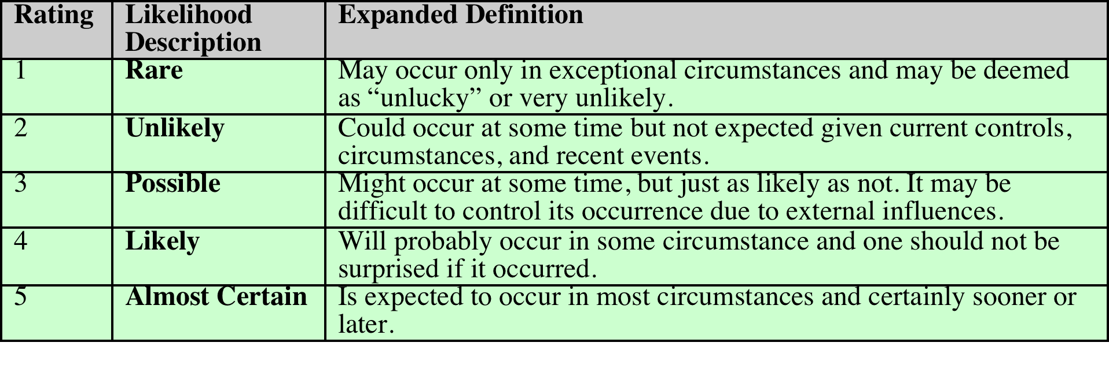
Risk Likelihood
There will very likely be some uncertainty and debate over exactly which rating is most appropriate
This reflects the qualitative nature of the ratings, ambiguity in their precise meaning, and uncertainty over precisely how likely it is that some threat may eventuate
It is important to remember that the goal of this process is to provide guidance to management as to which risks exist, and provide enough information to help management decide how to most appropriately respond
Notes:
Having identified existing controls, the likelihood
that each identified threat could occur and cause harm to some asset needs to
be specified. The likelihood is typically described qualitatively, using values and
descriptions such as those shown in Table 14.2. While the various risk assessment
standards all suggest tables similar to these, there is considerable variation in their
detail. The selection of the specific descriptions and tables used is determined at
the beginning of the risk assessment process, when the context is established.
There will very likely be some uncertainty and debate over exactly which rating
is most appropriate. This reflects the qualitative nature of the ratings, ambiguity
in their precise meaning, and uncertainty over precisely how likely it is that some
threat may eventuate. It is important to remember that the goal of this process is
to provide guidance to management as to which risks exist, and provide enough
information to help management decide how to most appropriately respond. Any
uncertainty in the selection of ratings should be noted in the discussion on their
selection, but ultimately management will make a business decision in response to
this information.
The risk analyst takes the descriptive asset and threat/vulnerability details
from the preceding steps in this process and, in light of the organization’s overall
risk environment and existing controls, decides the appropriate rating. This
estimation relates to the likelihood of the specified threat exploiting one or
more vulnerabilities to an asset or group of assets, which results in harm to the
organization. The specified likelihood needs to be realistic. In particular, a rating
of likely or higher suggests that this threat has occurred sometime previously. This
means past history provides supporting evidence for its specification. If this is
not the case, then specifying such a value would need to be justified on the basis
of a significantly changed threat environment, a change in the IT system that
has weakened its security, or some other rationale for the threat’s anticipated
likely occurrence. In contrast, the Unlikely and Rare ratings can be very hard to
quantify. They are an indication that the threat is of concern, but whether it could
occur is difficult to specify. Typically such threats would only be considered if the
consequences to the organization of their occurrence are so severe that they must
be considered, even if extremely improbable.

Slide 20
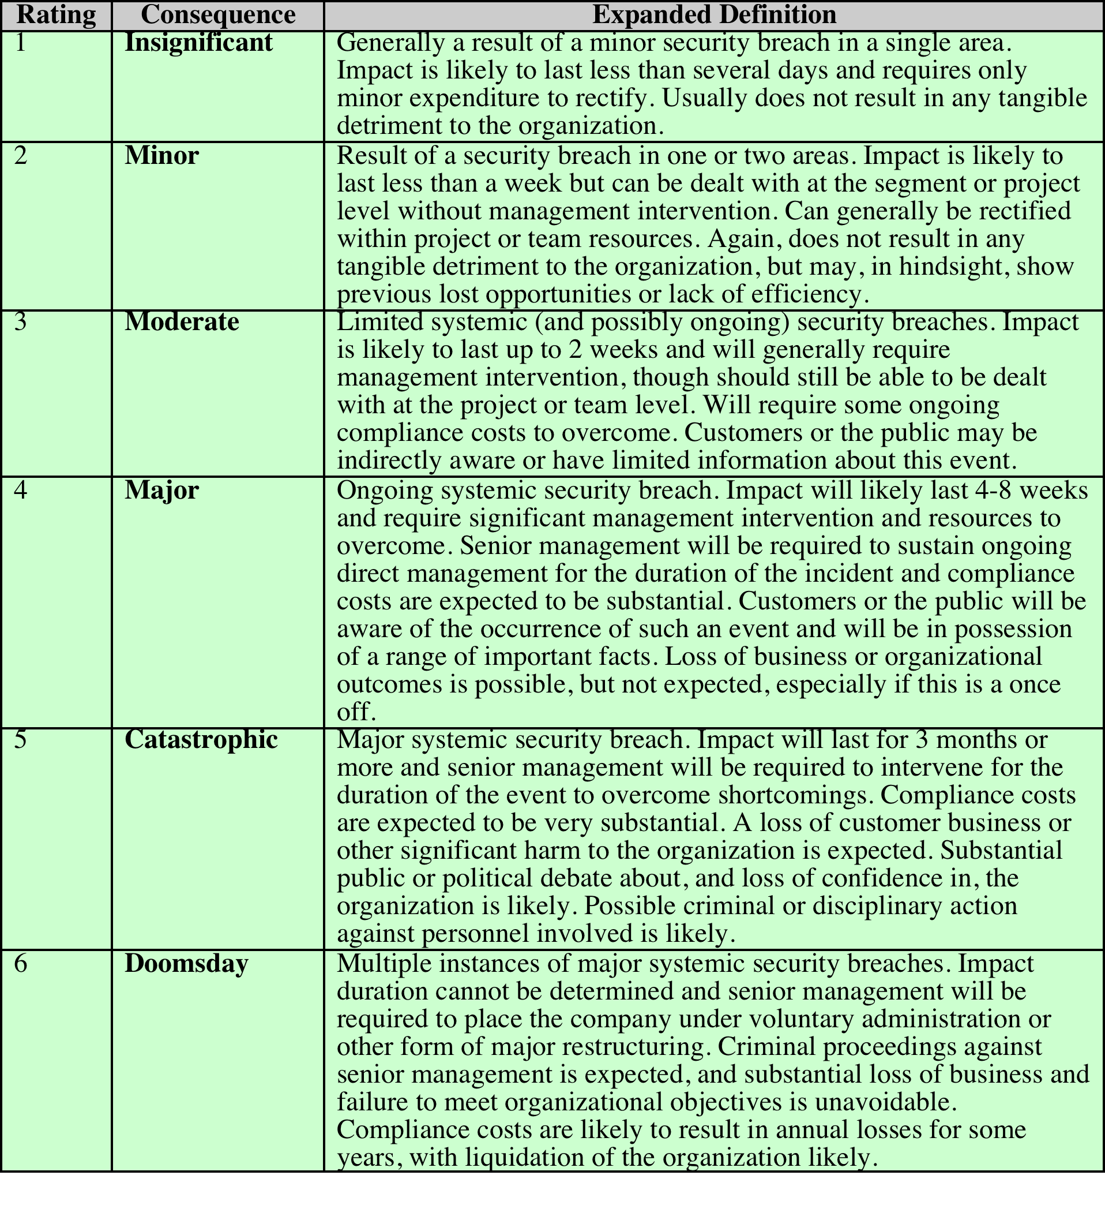
Risk Consequences
Notes:
The analyst must then
specify the consequence of a specific threat eventuating. Note this is distinct from,
and not related to, the likelihood of the threat occurring. Rather, consequence
specification indicates the impact on the organization should the particular threat
in question actually eventuate. Even if a threat is regarded as rare or unlikely, if
the organization would suffer severe consequence should it occur, then it clearly
poses a risk to the organization. Hence, appropriate responses must be considered.
A qualitative descriptive value, such as those shown in Table 14.3, is typically used
to describe the consequence. As with the likelihood ratings, there is likely to be
some uncertainty as to the best rating to use.
This determination should be based upon the judgment of the asset’s owners,
and the organization’s management, rather than the opinion of the risk analyst. This
is in contrast with the likelihood determination. The specified consequence needs to
be realistic. It must relate to the impact on the organization as a whole should this
specific threat eventuate. It is not just the impact on the affected system. It is possible
that a particular system (a server in one location, for example) might be completely
destroyed in a fire. However, the impact on the organization could vary from it being
a minor inconvenience (the server was in a branch office, and all data were replicated
elsewhere) to a major disaster (the server had the sole copy of all customer
and financial records for a small business). As with the likelihood ratings, the consequence
ratings must be determined knowing the organization’s current practices and
arrangements. In particular, the organization’s existing backup, disaster recovery,
and contingency planning, or lack thereof, will influence the choice of rating.

Slide 21
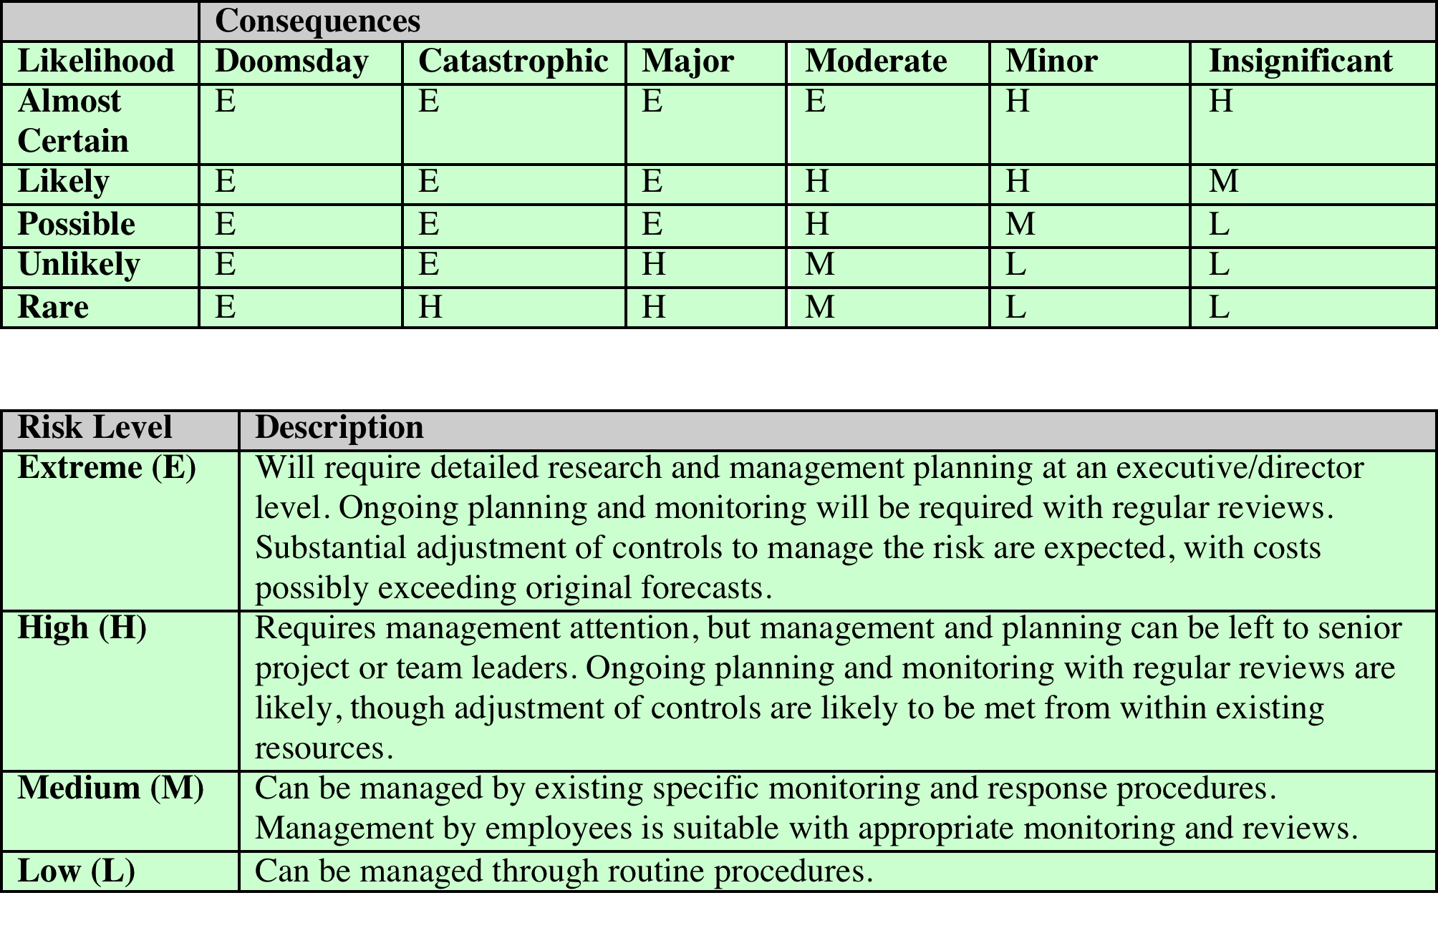
Risk Level Determination
***https://www.ready.gov/business/planning/risk-assessment
Notes:
Once the likelihood and consequence
of each specific threat have been identified, a final level of risk can be assigned.
This is typically determined using a table that maps these values to a risk level,
such as those shown in Table 14.4. This table details the risk level assigned to each
combination. Such a table provides the qualitative equivalent of performing the
ideal risk calculation using quantitative values. It also indicates the interpretation
of these assigned levels.

